Slide 1



Slide 1
Kubernetes
Why K8s is right for Abcam

Slide 2
Slide 10
Why are we here?
Assumptions
Share the benefits of Kubernetes and why it was selected for the Search project
Get feedback
Build closer ties between Engineering and Architecture
Microservices patterns are a desired state
Abcam needs a platform for innovation
Abcam wants to scale globally
10

Slide 3
Slide 1
Agenda
Kubernetes Presentation
Q&A
Pizza Break
Demonstration
Open Discussion

Slide 4

Slide 11
Do you have
any concerns?

Slide 5




















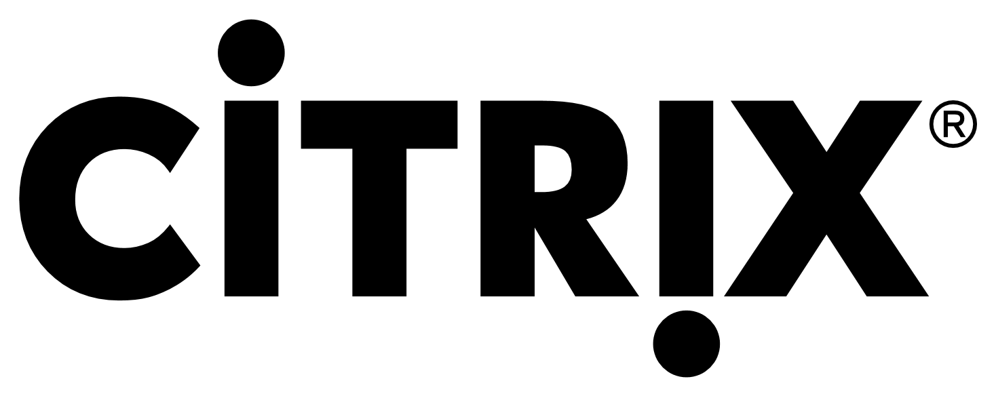

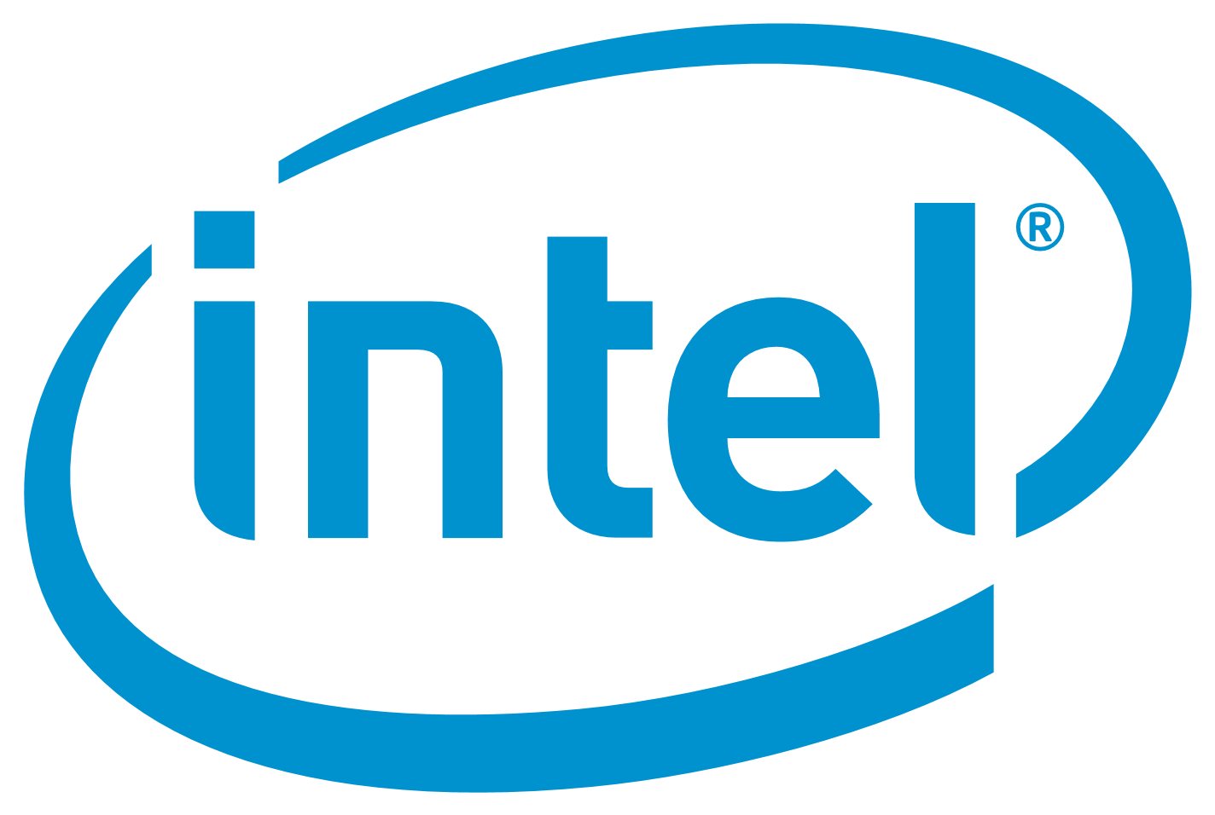








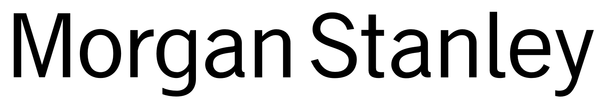




Slide 2
Foundation Members
2

Slide 6


Slide 2
IBM paid $34 Billion for it
2

Slide 7

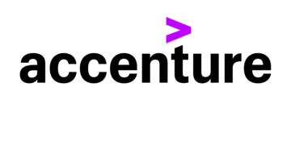





Slide 2
And some old friends use it…
2

Slide 8
Slide 11
WHY?

Slide 9
Slide 11
What problems are they trying to solve?

Slide 10
Slide 5
Problems faced by companies delivering software
AGILITY
VELOCITY
SCALING
Meeting strategic goals and responding to the market.
Delivering innovation that differentiates them from their competitors.
Reducing the Time to Value – turning innovative ideas into benefit and beating competitors to profit.
Meeting multiple business requirements at the same time.
Growing both delivery and expertise – responding to success in seconds and not months.
Expanding globally to reach their customers.
5

Slide 11

Slide 5
Problems faced by companies delivering software
COST
OPERATIONAL EFFICIENCY
SECURITY
Security – Reducing attack vectors and mitigating risk.
Compliance – meeting a business and governmental standards.
Reducing Total Cost of Ownership
Managing compute, operation, licensing and skill costs.
Reducing outages, downtime and failures.
Improving visibility, monitoring and tracing.
5

Slide 12
Slide 11
Then why do we need Kubernetes?
Time for a bit of history

Slide 13
Slide 9
In the beginning…
APPLICATION
Responsibility
OS
Bare metal
installation
Security
Testing
HARDWARE
9

Slide 14
Slide 9
The first virtualization revolution
A
A
A
A
OS
OS
OS
OS
Responsibility
Virtual
Machines
Hypervisor
Security
OS
Testing
HARDWARE
9

Slide 15
Slide 9
The cloud revolution
A
A
A
A
OS
OS
OS
OS
Responsibility
Cloud Virtual
Machines
Hypervisor
Security
OS
Testing
HARDWARE
9

Slide 16
Slide 9
Anatomy of a virtual machine
APPLICATION
OS
VIRTUALISED
HARDWARE
9

Slide 17
Slide 9
The next paradigm in computing
A
A
A
A
A
A
A
A
A
A
A
A
Responsibility
Containers
Container Engine
Security
OS
Testing
HARDWARE
9

Slide 18
Slide 9
Anatomy of a container
APPLICATION
BINARIES
LIBRARIES
9

Slide 19
Slide 9
Advantages of containers
Faster time to market
Development Velocity
Resource efficiency and density
Performance
Scaling – Never Outgrow
Security – Reduced Attack Vector
IT operational efficiency
Cost savings - Density
Speed - deploy in seconds
Agility
Freedom of choice – Language agnostic
Platform independence: Build it once, run it anywhere
9

Slide 20
Slide 11
Then why do we need Kubernetes?
Containers solve our problems!

Slide 21
Slide 11
Then why do we need Kubernetes?
Then why do we need Kubernetes?

Slide 22
Slide 9
Disadvantages of containers
Management
Scaling
Security, Auditing & Compliance
Development & Deployment
Monitoring
Reliability
9

Slide 23

Slide 9
The short history of Kubernetes
CONTAINERS
KUBERNETES
2004
2014
BORG
KUBERNETES v1.0
2006
2015
9

Slide 24
Slide 9
Anatomy of Kubernetes
P
P
P
P
P
P
P
P
P
P
P
P
NODE
NODE
NODE
NODE
MANAGEMENT PLANE
9

Slide 25
Slide 9
Benefits of Kubernetes
Management
Scaling
Security, Auditing
& Compliance
Orchestration, Desired State Management, Dashboards, Resource Management, Storage Management
Cluster and Application – Scale out, Scale up globally
RBAC, Policy Management, Secret & Configuration Management, Enforced TLS, Credentials Management
9
Notes:
Orchestration, dashboards, Resource Management, Storage.
Cluster and Application – Scale out and Scale up.
RBAC, Policy Management, Secret & Configuration Management, Enforced TLS.
Service Discovery, Load Balancing, Automated Deployments, Roll backs.
Logging & Tracing.
Self Healing, Health checking, True Multi-Cluster.
Extras

Slide 26
Slide 9
Benefits of Kubernetes
Development & Deployment
Monitoring
Reliability
Service Discovery, Load Balancing, Automated Deployments, Roll backs, Replica Sets
Logging & Tracing
Self Healing, Health checking, True Multi-Cluster
9
Notes:
Orchestration, dashboards, Resource Management, Storage.
Cluster and Application – Scale out and Scale up.
RBAC, Policy Management, Secret & Configuration Management, Enforced TLS.
Service Discovery, Load Balancing, Automated Deployments, Roll backs.
Logging & Tracing.
Self Healing, Health checking, True Multi-Cluster.
Extras

Slide 27
Slide 9
Kubernetes Cons
Complexity/Number of options
Knowledge
Skillset
Managed service
K8S SME
9

Slide 28
Slide 9
Kubernetes at Abcam
Innovation Platform
Support Project Sherpa
Break the monolith
Scale globally
Attract talent and retain staff
9

Slide 29
Slide 10
Feedback on the plan and designs
How you can help
Talk to your network
We need your assistance to develop the platform to deliver the most benefits to Abcam
Identify suitable business need
Advocate for the Innovation Platform
10

Slide 30
Slide 11
THANK YOU

